Slide 1
Introduction to Applied Statistics & Concept of Probability
Shovan Bhowmik
Lecturer
Dept. Of CSE(BAIUST)

Slide 2
Introduction to Statistics
Statistics is a branch of mathematics dealing with data collection, organization, analysis, interpretation and presentation of data.
Google says, Statistics means the practice or science of collecting and analyzing numerical data in large quantities, especially for the purpose of inferring proportions in a whole from those in a representative sample.
Statistical analysis is implemented to manipulate, summarize and investigate data so that useful decision making information results are obtained.
Statistics deals with every aspects of data, including the planning of data collection in terms of the design of surveys and experiments.

Slide 3
Types of Statistics
Descriptive Statistics: It is a method of organizing, summarizing and presenting data in an informative way.
Inferential Statistics: It is a method which is used in determining something about a population on the basis of a sample.
Population: The entire set of individuals or objects of interest or the measurements obtained from all individuals or objects of interest.
Sample: A portion or part of the population of interest.

Slide 4
Applied Statistics
The term Applied Statistics is used both to denote the work of professional statisticians, who are responsible for the production and presentation of statistics, and to refer to the processes of statistical interpretation that are undertaken by professional statisticians, by professional users of statistics and by the general public.
It makes frequent use of Statistics Theory but it is distinct from the mathematics of that theory.
It has made major contributions to scientific research and to the conduct of operational activities in a variety of fields.

Slide 5
Applications of Statistics
Some major applications of Applied Statistics are:
Medicine and Criminology
Climatology
Cost/ Benefit Analysis
Decision Making
Statistical Inference
Estimation
Testing Hypothesis etc..

Slide 6
Probability and Statistics
In the study of statistics we are concerned basically with the presentation and interpretation of chance outcomes that occur in a planned study or scientific investigation.
Statistics may deal with numerical, categorical data as an observation.
It uses the word experiment to describe any process.
For example: Tossing coin experiment
Probability theory and Statistics are branches of mathematics that deals with Uncertainty.

Slide 7
Some Definitions
Experiment: A repeatable process that yields a result or an observation
Outcome: An elementary result of an experiment
Sample Space: A collection of all possible outcomes of an experiment
Denoted by S
Sample Point / Elementary Event: An element of S
Event: A set of outcomes (a subset of the sample space)
A sample space of n outcomes yields 2^{n} possible events.
Certain Event (S) : Happens with certitude at each repetition of an experiment
Impossible Event (φ) : Never takes place in a random experiment

Slide 8
Some Definitions(Cont..)
A sample space is discrete if it consists of a finite or countable infinite set of outcomes.
Examples:
Rolling a die:
S = {1, 2, 3, 4, 5, 6}
S = {odd, even}
Tossing a coin:
S = {H, T}
Tossing a coin, if head comes roll a die else toss again:
S = {H1,H2,H3,H4,H5,H6,TT}
Depends on the objective

Slide 9

Some Definitions(Cont..)
A sample space is continuous if it contains an interval (either finite or infinite) of real numbers.
Examples:
Height of students: Observe the height in ft of a randomly chosen student.
S = [4,7]; all real numbers between 4 to 7.
Sample space with a large number of sample points are best described by a statement or rule method.
S is the set of all points (x,y) on the boundary or the interior of a circle of radius 2 with centre at origin.
S = { x | x is a city with a population over 1 million}
S = { (x , y) | $x^{2}+y^{2}≤4\}$

Slide 10
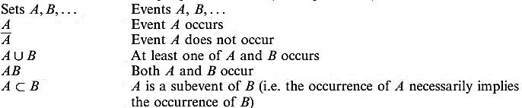
Operations with Events
The language and concepts of set theory provide a natural context for the development of probability theory.

Slide 11
Operations with Events(Cont..)
A\B (Difference) = A ꓵ B’ = The event A occurs but B does not
Events A, B, C, ….. are disjoint ( or mutually exclusive) if
A U B U C U … = φ
Disjoint events cannot occur at the same time.
Events A, B, C, …. are exhaustive A U B U C U ….. = S
Commutative law E ∪ F = F ∪ E E ∩ F =F ∩ E Associative law (E ∪ F ) ∪ G = E ∪ (F ∪ G ) (E ∩ F ) ∩ G = E ∩ (F ∩ G ) Distributive law (E ∪ F ) ∩ G = (E ∩ G) ∪ (F ∩ G) (E ∩ F) ∪ G = (E ∪ G ) ∩(F ∪ G )

Slide 12


Counting Techniques with examples
Multiplication rule: If an experiment consists of k components (sub- experiments) for which the number of possible outcomes are n₁, n₂, …, n_{k} then the total number of experimental outcomes (the size of the sample space) is equal to n₁× n₂ × … × n_{k}.
The design for a Website is to consist of four colors, three fonts, and three positions for an image. From the multiplication rule, 4 × 3 × 3 = 36 different designs are possible.

Slide 13
Operations with Events(Cont..)
An electronic controlling mechanism requires 5 distinct, but interchangeable, memory chips. In how many ways can this mechanism be assembled by placing chips in the odd numbered positions within the controller?
Ans: 5P3.
A young boy asks his mother to get 5 Game-BoyTM cartridges from his collection of 10 arcade and 5 sports games. How many ways are there that his mother can get 3 arcade and 2 sports games?
Ans: 10C3 x 5C2 = 1200.

Slide 14
Probability
Probability in daily life conversation:
“It is very likely that the plane will arrive late”
“The chances are good that he will be able to join us for dinner”
Probability is used to quantify the
Chance (Common Sense)
Liklihood (Forecasting)
Long Term Proportion (Relative frequency)
An outcome of a random experiment will occur.
For example: “The chance of rain today is 30% “

Slide 15

Axioms of Probability
Axiom 1: for each event A in S, P(A) ≥ 0 (nonnegative).
Axiom 2: P(S) =1 (normed).
Axiom 3: for a collection of mutually exclusive events A₁, A₂, . . . in S
Axioms of probability define the properties of a probability measure.
(additive).

Slide 16
Rules of Probability
P(φ) = 0
Addition rule:
If A and B are any events in S, then P(A ∪ B) = P(A) + P(B) - P(A ∩ B)
For mutually exclusive events, P(A ∪ B) = P(A) + P(B)
Complement rule: P (A’) = 1 - P (A).

Slide 17
Example
Suppose the manufacturer’s specifications for the length of a certain type of computer cable are 2000±10 millimeters. In this industry, it is known that small cable is just as likely to be defective (not meeting specifications) as large cable. That is, the probability of randomly producing a cable with length exceeding 2010 millimeters is equal to the probability of producing a cable with length smaller than 1990 millimeters. The probability that the production procedure meets specifications is known to be 0.99.
What is the probability that a cable selected randomly is too large?
What is the probability that a randomly selected cable is larger than 1990 millimeters?

Slide 18
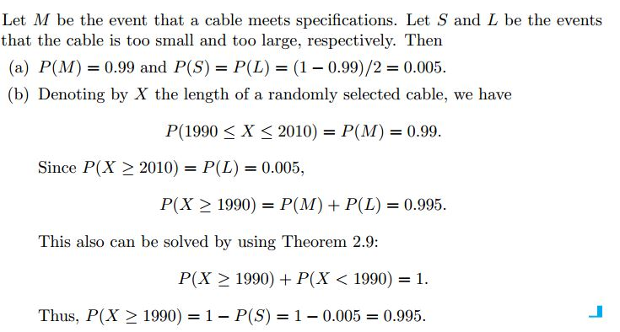
Example(Cont..)
Solution:

Slide 19
Rules of Probability - Independent Events
Events A and B are independent if they occur independently of each other.
Occurrence of one event does not affect the probability of other.
Decide which pair of events are dependent or independent ?
1. Toss a coin. Then roll a number cube (die).
2. Choose a bracelet and put it on. Choose another bracelet.
3. Select a card. Do not replace it. Then select another card.
4. Select a card. Replace it. Select another card.
5. Pick one flower from a garden, then pick another.

Slide 20
Rules of Probability - Independent Events(Cont..)
Ans: 1, 4 Independent.
For independent events – Multiplicative rule P(A∩B) = P(A) P(B )
P (E₁ ∩ ... ∩ E_{n}) = P(E₁)x ... x P(E_{n})

Slide 21
Example
There is a 5% probability for a hard drive to crash. Therefore, it has a backup having a 10% probability to crash, and all components are independent of each other. The stored information is lost only when all devices crash. What is the probability that the information is saved?
H = { hard drive crashes } B = {backup crashes }
P (H) = 0.05, and P(B) = 0.1
P (saved) = 1 – P(lost)
= 1 - P (H ∩ B) = 1 – P(H) P(B)
= 1 – 0.05*0.1
= 0.995

Slide 22
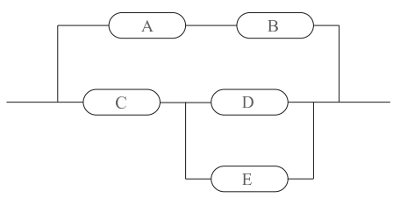
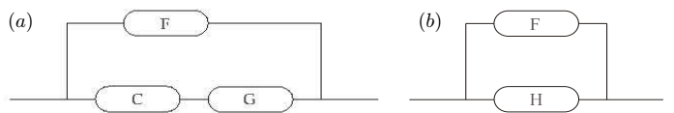
Example(Cont..)
Calculate reliability of the system in Figure if each component is operable with probability 0.92 independently of the other components.
P(A ∩ B) = (0.92)² = 0.8464 = P(F)
P(D ∪ E) = 1 – P(D’ ∩ E’)
= 1 – P(D’)P(E’)
= 1- {1-P(D)} {1-P(E)}
= 1 - (1 - 0.92)² = 0.9936 = P(G)
P (C ∩ G) = 0.92 * 0.9936 = 0.9141 = P(H)
P (F ∪ H) = 1 - (1 - 0.8464)(1 - 0.9141)
= 0.9868

Slide 23

Conditional Probability
The probability of an event B occurring when it is known that some event A has occurred is called a conditional probability and is denoted by P(B|A).
, provided P (A) > 0
Example: Loaded Rolling Die
A = {perfect square} = {1, 4}, P(A) = 1/9 + 2/9 = 1/3
B = {greater than 3} = {4, 5 , 6} = 5/9
A ∩ B = {4} = 2/9
What is the probability that the no. is a perfect sq given it is known that no > 3
P(A|B) = (2/9)/(5/9) = 2/5

Slide 24
Conditional Probability(Cont..)
Ninety percent of flights depart on time. Eighty percent of flights arrive on time. Seventy-five percent of flights depart on time and arrive on time. You are meeting a flight that departed on time. What is the probability that it will arrive on time?
Solution:
A = {arriving on time} D = {departing on time} P (A) = 0.8, P (D) = 0.9, P(A ∩ D) = 0.75.
P(A | D) = P (A ∩ D) / P(D) = 0.75 / 0.9 = 0.8333

Slide 25
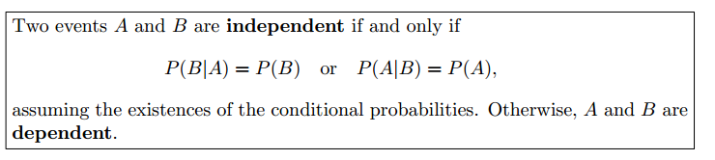
Independent Events
Example:
2 cards are drawn in succession from an ordinary deck, with replacement. The events are:
A: the first card is an ace
B: the second card is a spade
Here,
P (B|A) = 1/4 and P (B) = 13/52 = 1/4

Slide 26
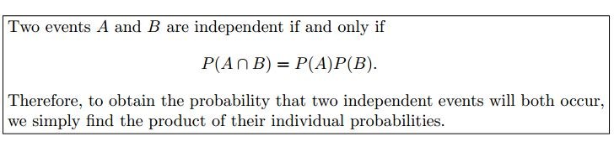
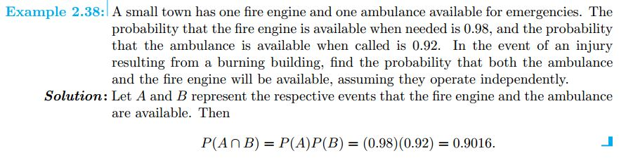
Multiplicative Rule(Independent Events)

Slide 27

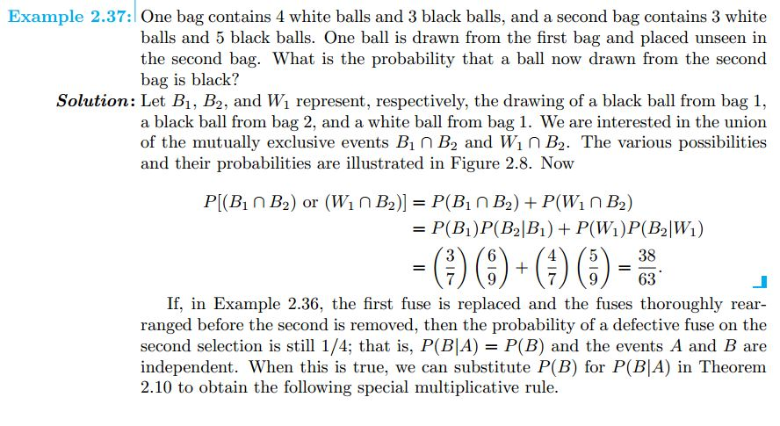
Multiplicative Rule(Dependent Events)

Slide 28
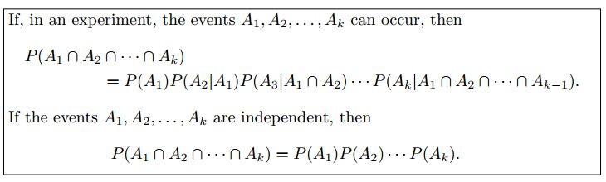
Extension of Multiplicative Rule

Slide 29
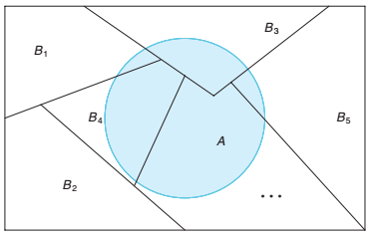
Partitions and Total Probability
Partitions: A collection of sets B₁, B₂, . . . , B_{k} is said to partition the sample space if the sets (i) are mutually disjoint and (ii) have as union the entire sample space.
Total Probability: If the events B₁, B₂, . . . , B_{k} constitute a partition of the sample space S such that P (B_{i}) ≠ 0 for i = 1, 2, . . . , k, then for any event A of S.
Partitioning the sample space S

Slide 30
Bayes’ Rule
For Two events:
General Case:
If B₁, B₂, . . . , B_{n} partition the sample space S, then for each i = 1, 2, . . . , n and any set A

Slide 31
Exercise
Do it by yourself. You can take help from solution manual.
Exercise List from Walpole’s Book:
2.51, 2.52, 2.53, 2.59, 2.64, 2.65, 2.66, 2.67, 2.69, 2.71, 2.75, 2.77, 2.83, 2.88, 2.90, 2.93, 2.94, 2.96, 2.106, 2.111, 2.115, 2.119, 2.127
also solve the example problems that I have done in the classes

Slide 32
References
Probability and Statistics for Engineers and Scientists(9th Edition) – Walpole
Probability and Statistics for Computer Scientists(4th Edition) – Sheldon Ross

Slide 33


